Slide 1
Predicting Diabetes
by Ryan Talbot
Notes:
Hello! My name is… and today I’m excited to present my machine learning project titled 'Predicting Diabetes Status Using CDC Health Indicators'. In the next 10 minutes, I’ll walk you through the problem I’ll be addressing, the machine learning approach I used, and the key results I achieved.

Slide 2

Problem Description
Notes:
Diabetes is a chronic condition affecting millions worldwide. Early prediction and intervention are crucial for improving patient outcomes and reducing healthcare costs. However, accurately identifying individuals at risk—whether they are diabetic, pre-diabetic, or healthy—remains a significant challenge. This is where my project comes in.

Slide 3
Objectives
1. Predictive Modeling
2. Model Evaluation
Notes:
my project has two main objectives:
Predictive Modeling: use a supervised machine learning model to classify individuals into diabetic, pre-diabetic, or healthy categories based on various health indicators and lifestyle factors.
Model Evaluation: Assess the performance of this model using appropriate metrics to ensure its reliability and effectiveness.

Slide 4

Dataset
Notes:
I utilized the CDC Diabetes Health Indicators Dataset, which includes comprehensive healthcare statistics and lifestyle survey information. Let me give you a quick overview:
Number of Instances: 253,680
Number of Features: 21
Target Variable: Diabetes_binary, where 0 indicates no diabetes and 1 indicates pre-diabetes or diabetes.
The features encompass demographics like sex, age, education level, income, and health indicators such as BMI, blood pressure, cholesterol levels, smoking status, and physical activity, among others.

Slide 5
Data Preprocessing
Missing Values
Encoding
Split Dataset
Notes:
Before building my models, I performed several data preprocessing steps:
Handling Missing Values: I addressed any missing data through appropriate imputation techniques to ensure data quality.
Categorical Variable Encoding: Categorical features were encoded using methods like One-Hot Encoding to make them suitable for machine learning algorithms.
Test-Train Split: The dataset was split into training and testing sets to evaluate model performance effectively.

Slide 6
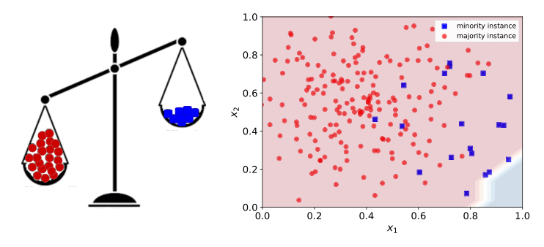
Class Imbalance
Notes:
One of the key challenges I faced was class imbalance—where the number of non-diabetic cases significantly outweighed diabetic cases. To tackle this, I employed SMOTE, which stands for Synthetic Minority Oversampling Technique. SMOTE generates synthetic samples for the minority class, helping the model learn to recognize diabetic cases more effectively.

Slide 7

Model Selection and Training
Notes:
For my predictive modeling, I chose the Random Forest classifier due to its robustness and ability to handle feature interactions well. I trained two versions of the model:
Without SMOTE: To establish a baseline performance.
With SMOTE: To assess the impact of handling class imbalance on model performance.

Slide 8
Without SMOTE
Accuracy: 87%
Class 0 (No Diabetes): Precision 88%, Recall 98%, F1-Score 93%
Class 1 (Diabetes): Precision 57%, Recall 14%, F1-Score 23
AUC Score: 0.77

Slide 9
SMOTE
Accuracy: 79%
Class 0 (No Diabetes): Precision 91%, Recall 84%, F1-Score 87%
Class 1 (Diabetes): Precision 32%, Recall 48%, F1-Score 39%
AUC Score: 0.77

Slide 10
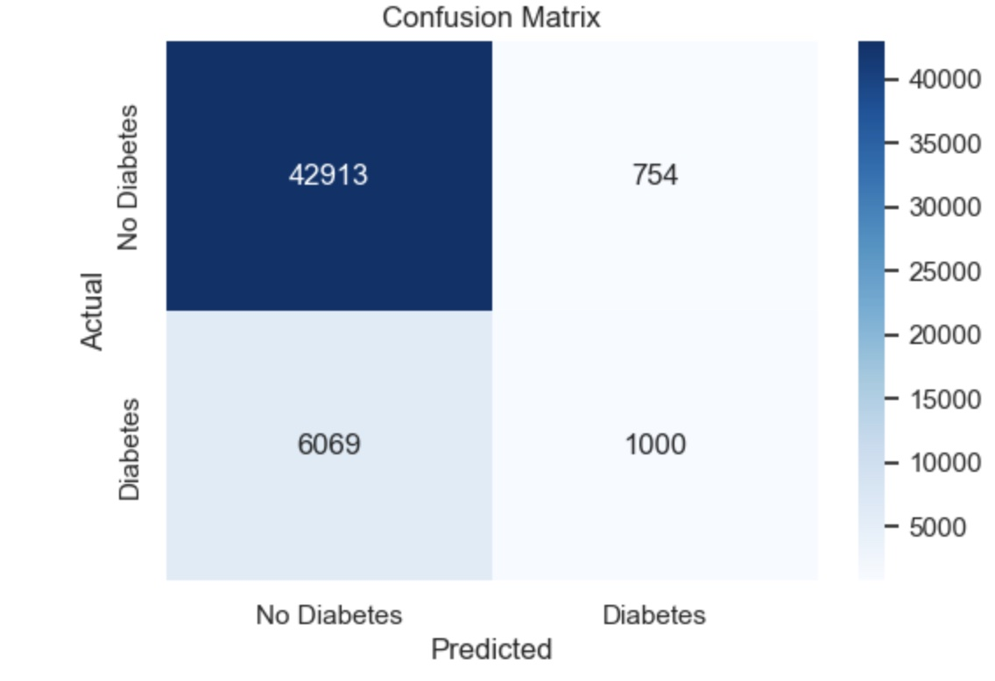
Visual Comparison
SMOTE
Without SMOTE
Notes:
Here you can see a side-by-side comparison of the confusion matrices and ROC curves for both models. The model with SMOTE shows a reduction in false negatives, which is crucial for healthcare applications where missing diabetic cases can have severe consequences. The ROC curves remain the same, indicating consistent overall discriminatory power.

Slide 11
Key Observations
Class Imbalance
Precision and Recall
Feature Importance
Notes:
From my analysis, several key observations emerge:
Impact of Class Imbalance: Without addressing class imbalance, the model was biased towards the majority class, leading to poor recall for diabetic cases.
Trade-Off Between Precision and Recall: Applying SMOTE improved recall but decreased precision, highlighting the balance between reducing false negatives and managing false positives.
Feature Importance: Features like BMI, high blood pressure, and cholesterol levels were significant predictors of diabetes, aligning with clinical knowledge.

Slide 12

Summary
Notes:
In summary, my Random Forest model demonstrates strong performance in identifying non-diabetic individuals but initially struggled with diabetic case identification due to class imbalance. By applying SMOTE, I significantly improved the model’s ability to recall diabetic cases, albeit with a trade-off in precision. The consistent AUC score of 0.77 indicates moderate overall effectiveness, suggesting room for further optimization.

Slide 13

Conclusion
Notes:
In conclusion, my project successfully developed a machine learning model to predict diabetes status, addressing the critical challenge of class imbalance with SMOTE. While the model shows promise, especially in improving recall for diabetic cases, further enhancements are necessary to optimize its precision and overall effectiveness. Thank you for ymy attention!

